Slide 1
Segmentation for medical image with ambiguous boundary
Tooth instance segmentation and identification
Anyu Zhu
2020.6.13

Slide 2


Slide 3
Contributions
proposed a novel boundary key point selection algorithm that best fit the target region. (BPB with boundary key point map generator)
In the proposed framework, employ boundary key point information automatically without the user interaction.
The proposed method can be generalized to different segmentation models. The proposed method improves the prediction performance with statistical significance.

Slide 4
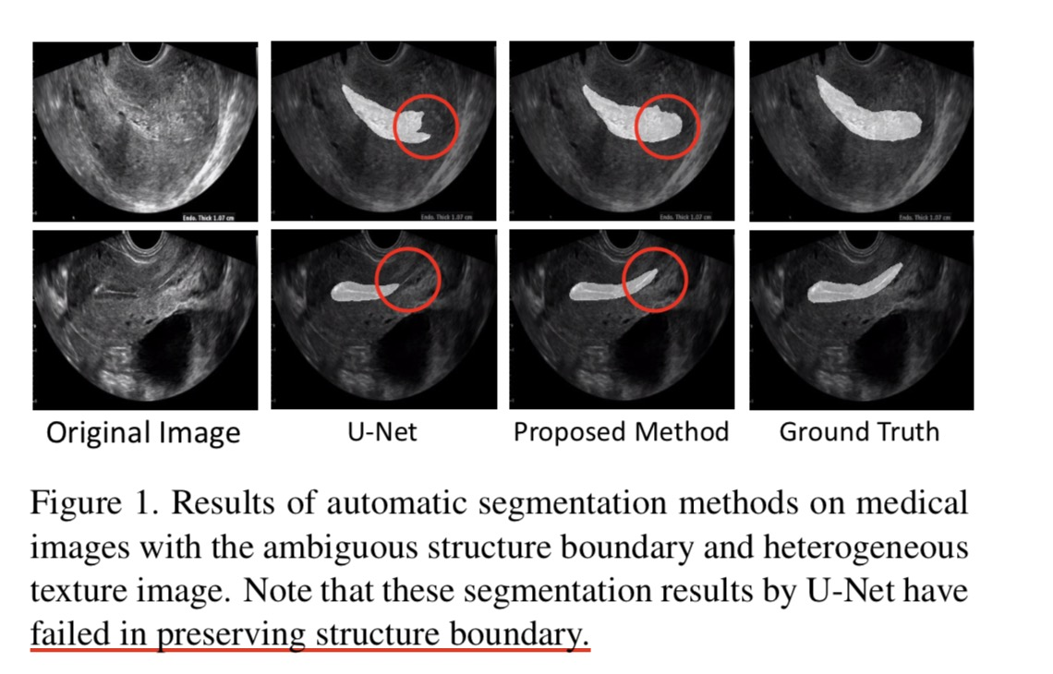

Slide 5
First, most of the medical images in application contain ambiguous boundaries because of poor image quality and heterogeneous textures.
Second, it is difficult to automatically predict the correct target region without knowledge of experts such as melanocytic lesions in ultrasound image.

Slide 6
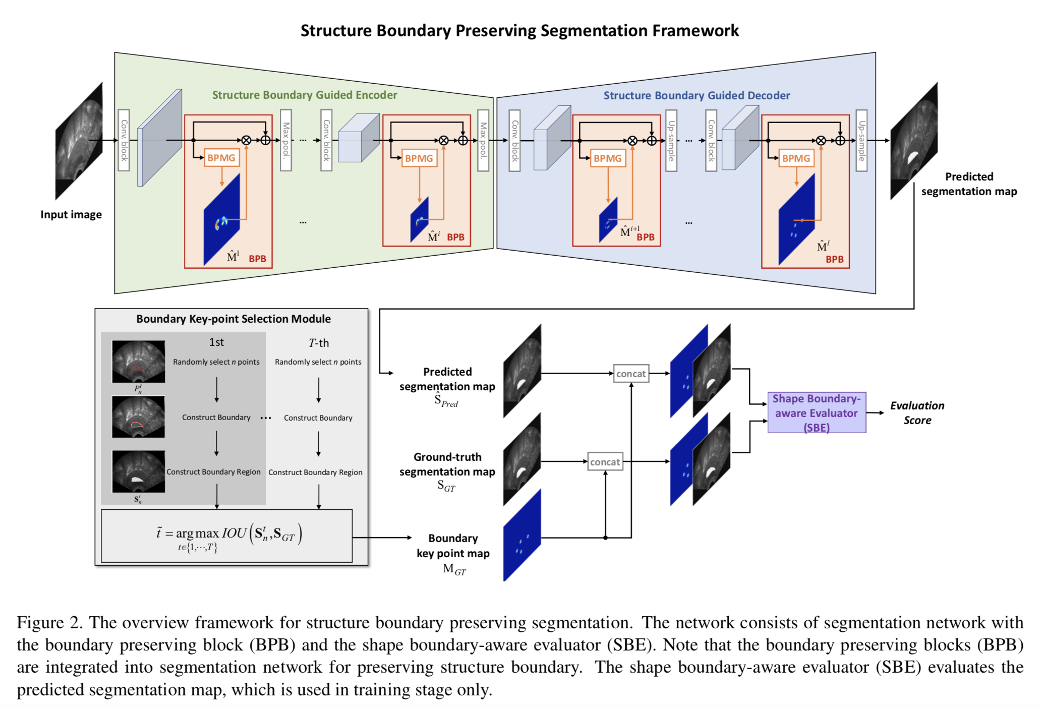

Slide 7
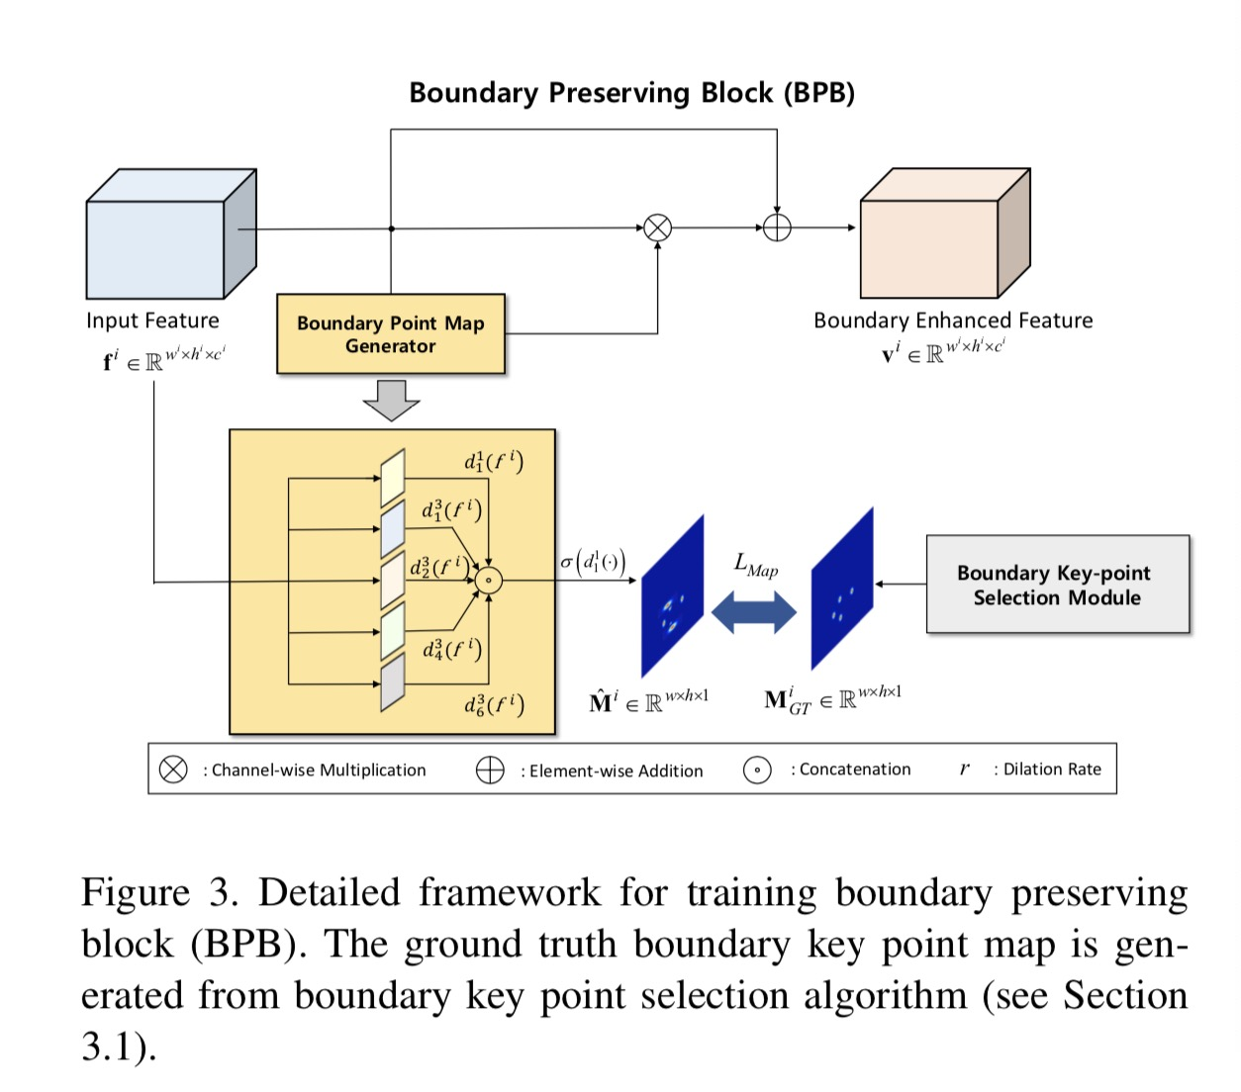
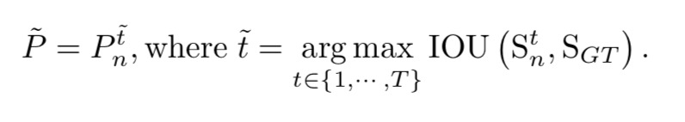
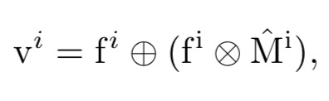
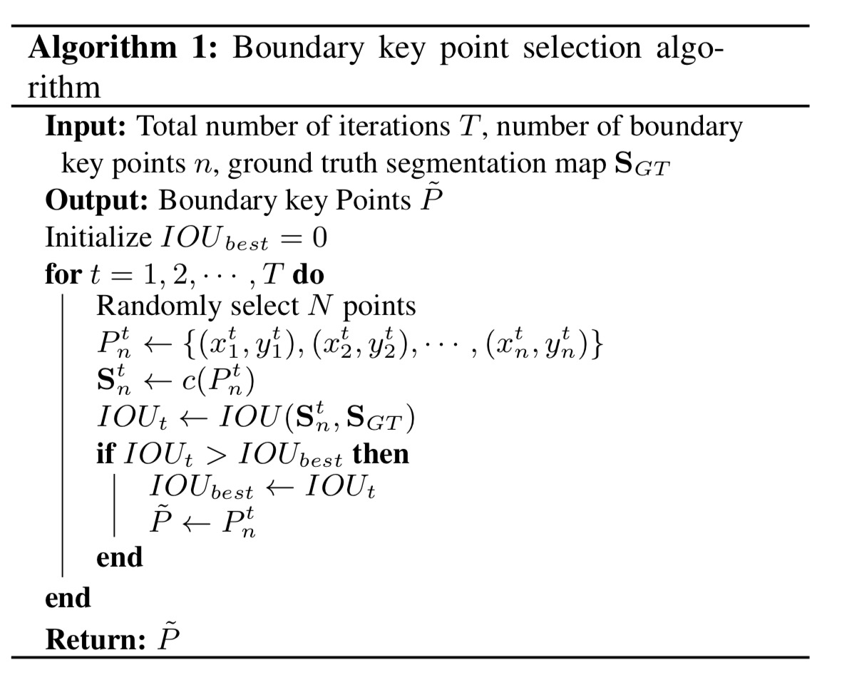
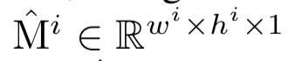
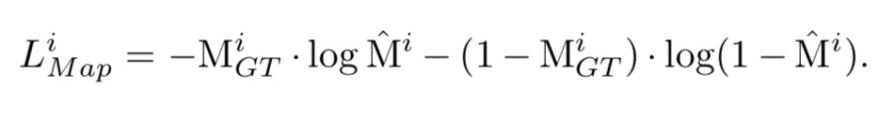
Then convert to a 2-dim boundary point map

Slide 8
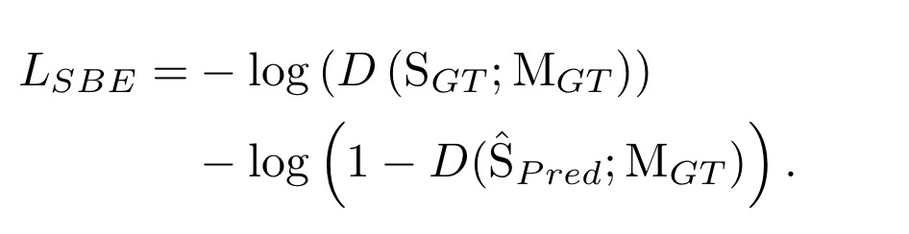
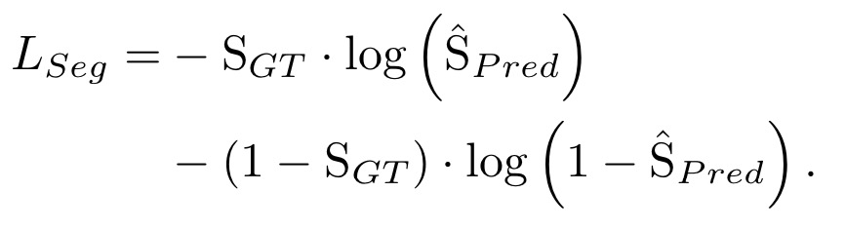
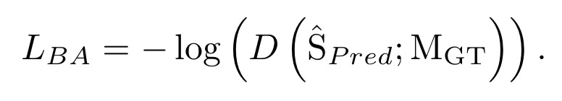
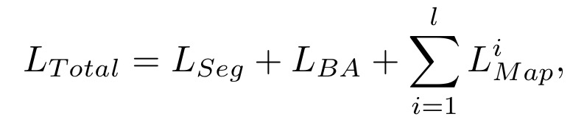
Shape Boundary-aware Evaluator (SBE)
Given the ground-truth segmentation map SGT and boundary key point map, the SBE provides a high evaluation score. On the other hand, with the poorly predicted segmentation map and boundary key point map, the SBE provides a low evaluation score
Training Segmentation Network

Slide 9
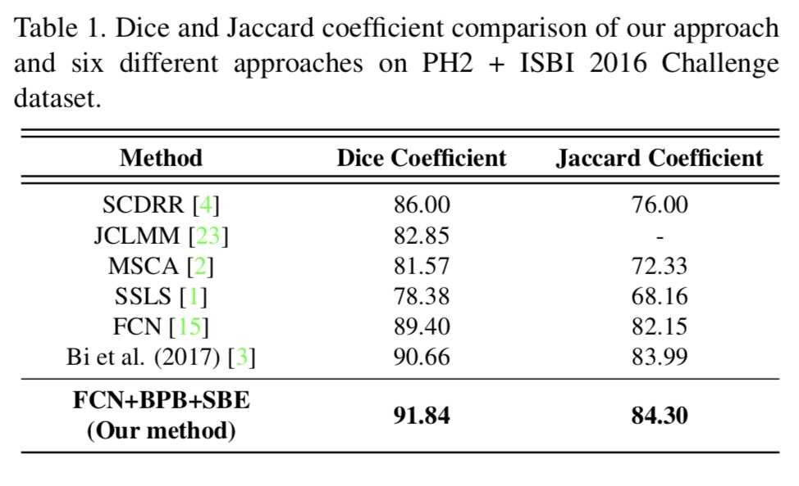
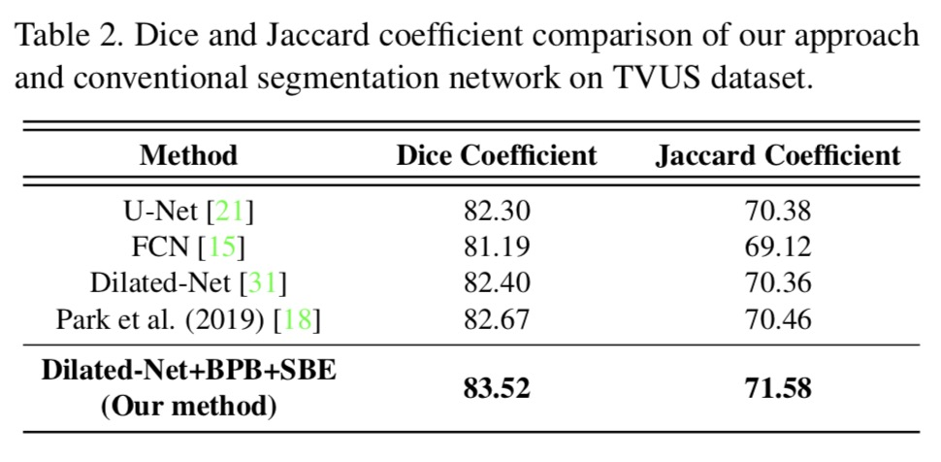
Quantitative Evaluation

Slide 10
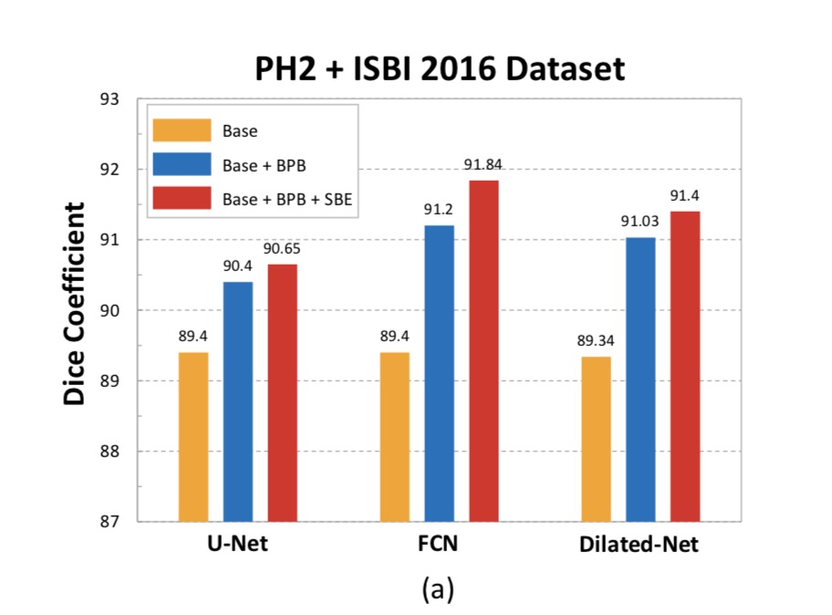
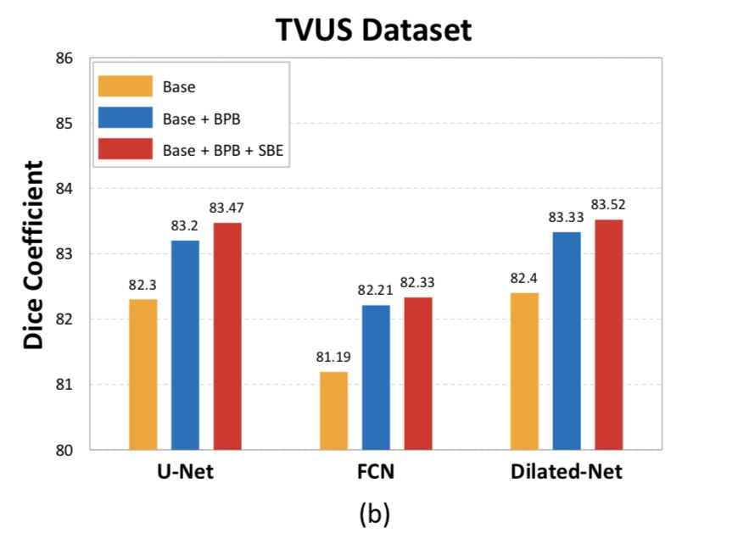
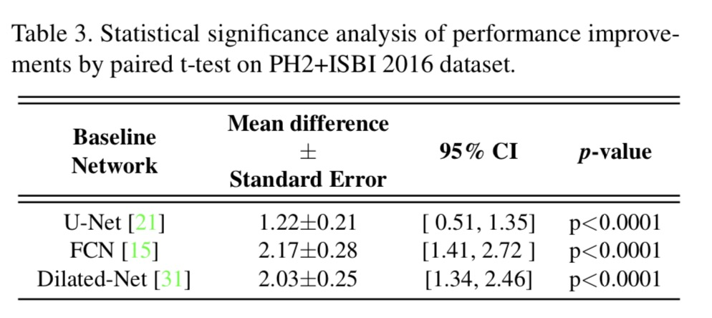
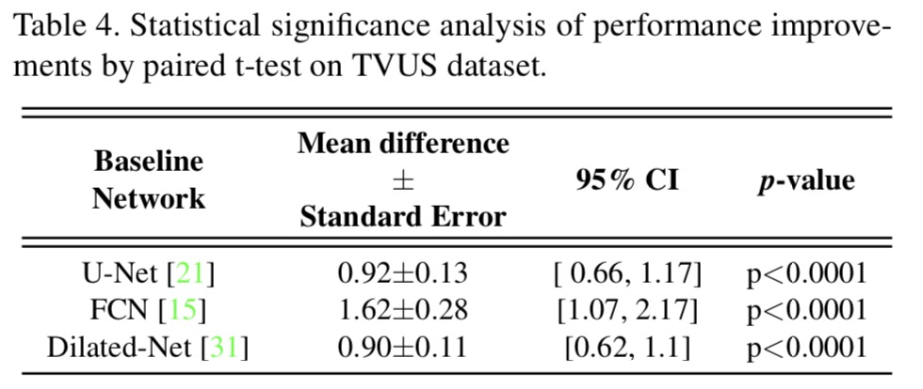
Ablation Study

Slide 11
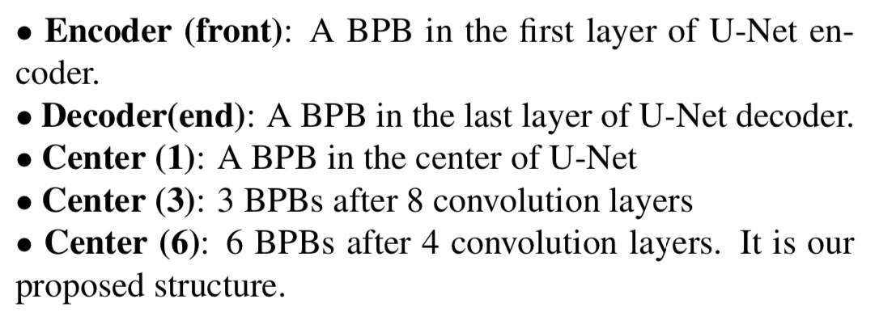
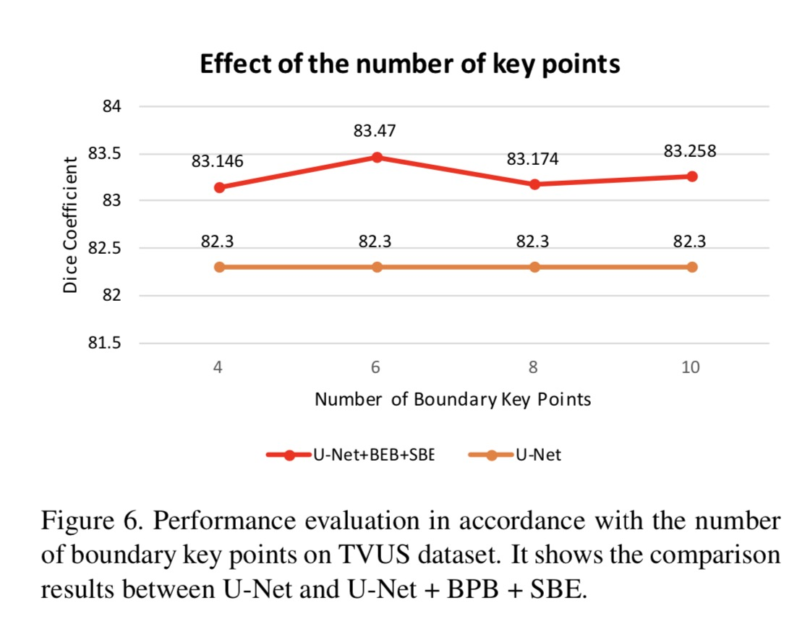
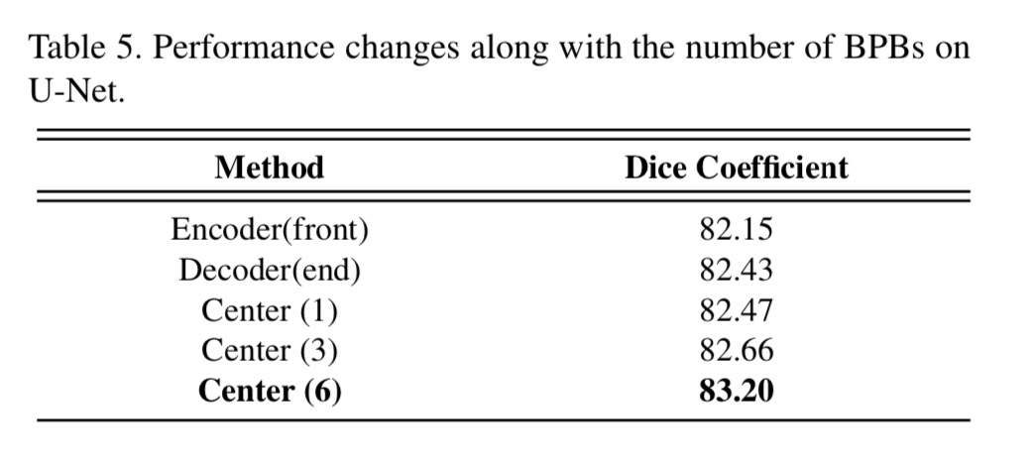

Slide 12
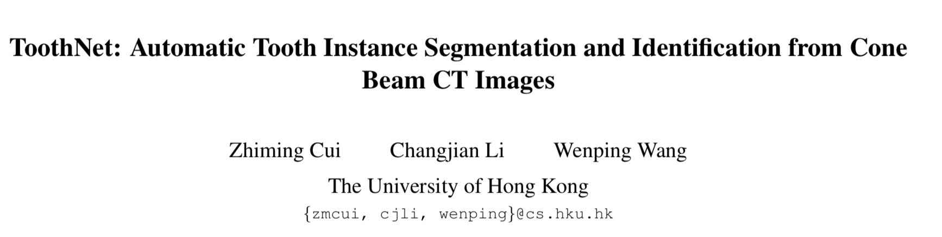

Slide 13
Contributions
Propose the first deep learning solution for accurate tooth instance segmentation and identification from CBCT images.
The proposed method significantly outperforms all other existing methods both qualitatively and quantitatively.
Make the popular RPN-based framework suitable for 3D applications with lower GPU memory and less training time requirements
It can be generalized to other medical image processing tasks in the future.

Slide 14
Methods
Base Network
Extend the pipeline of Mask R-CNN to a 3D version
backbone feature extraction module: apply five 3D convolutional layers to CBCT images.
Then feed encoded features into the 3D RPN module
Add one more branch for identification.
Proposed Network
A two-stage deep neural network.
In the first stage, extract the edge map from CBCT images by a deep supervised network.
In the second stage, concat the learned edge map features with the original image features and send them to the 3D RPN.
Use a learned similarity matrix to filter the plenty of redundant proposals inner the 3D RPN module
One spatial relationship component to further resolve the ambiguity of tooth identification

Slide 15
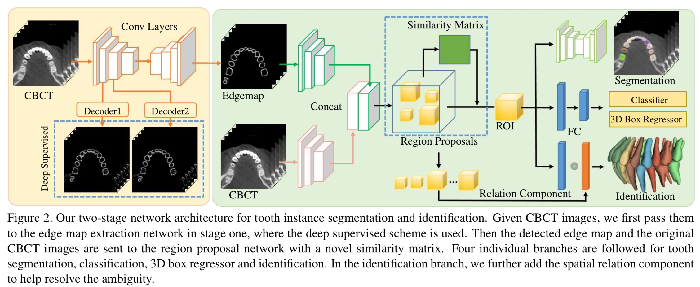

Slide 16
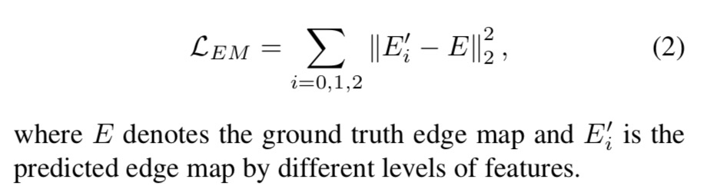
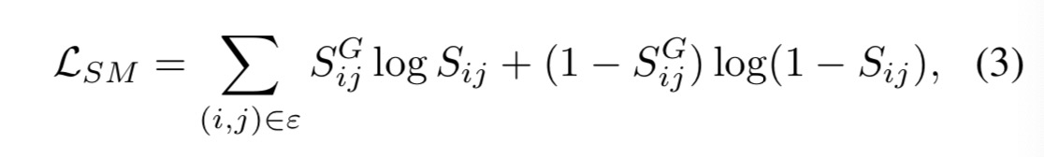
Edge Map Prediction and Representation
Similarity Matrix
First obtain the top-k (k=256 is used) ranked proposals generated by 3D RPN, denoted as P = {P0, P1, ..., Pk}. the element Sij represents the possibility of proposals Pi and Pj containing the same tooth.
In testing stage, for any pair of proposals {Pi , Pj }, if the element Sij > 0.5, discard the duplicate proposal with a lower classification score.

Slide 17
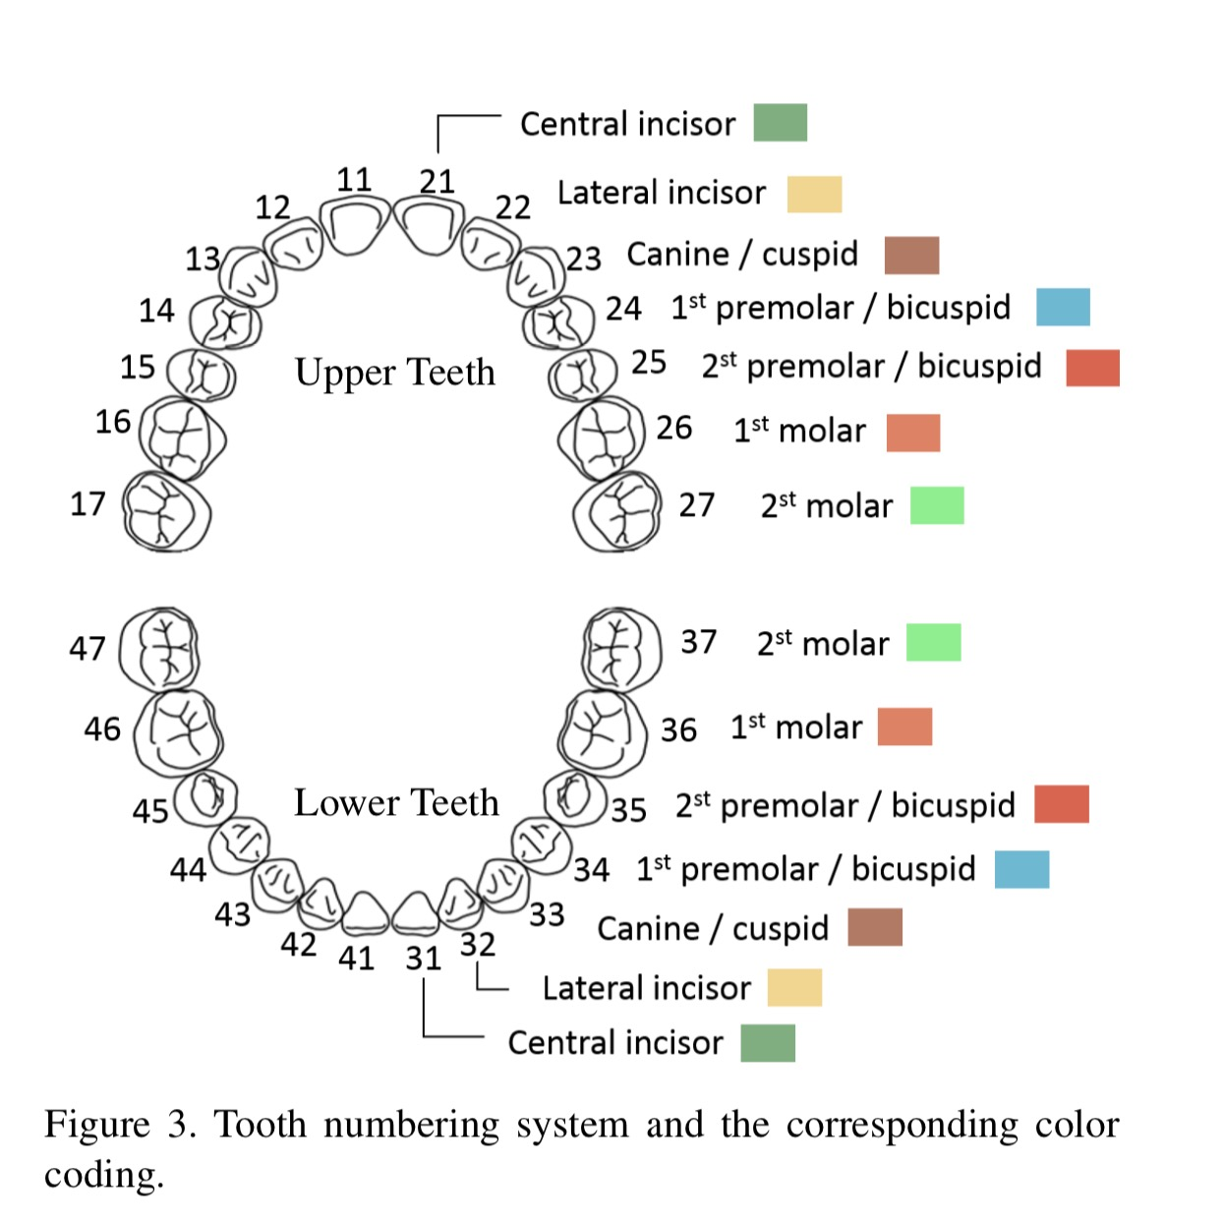
Tooth Identification
Build the relation feature as a weighted sum of shape features from all other proposals.
The identification branch takes the shape feature and relation feature as input, which is supervised by the ground truth label using a soft-max function.

Slide 18
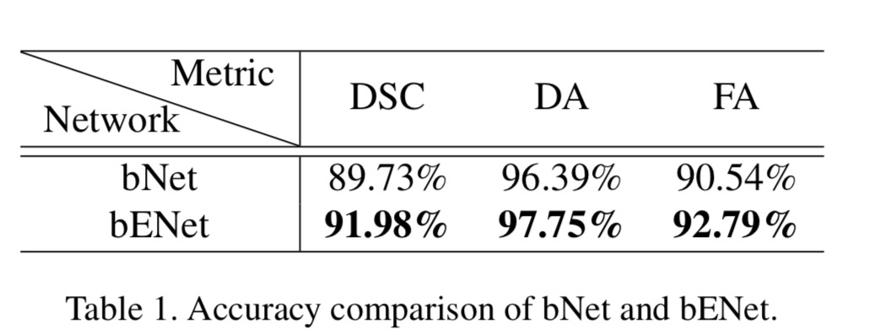
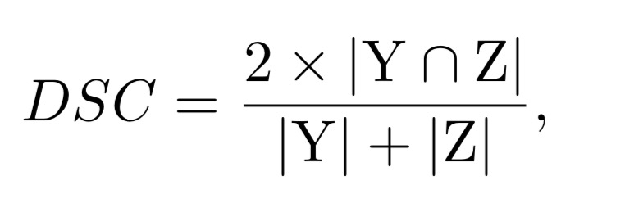
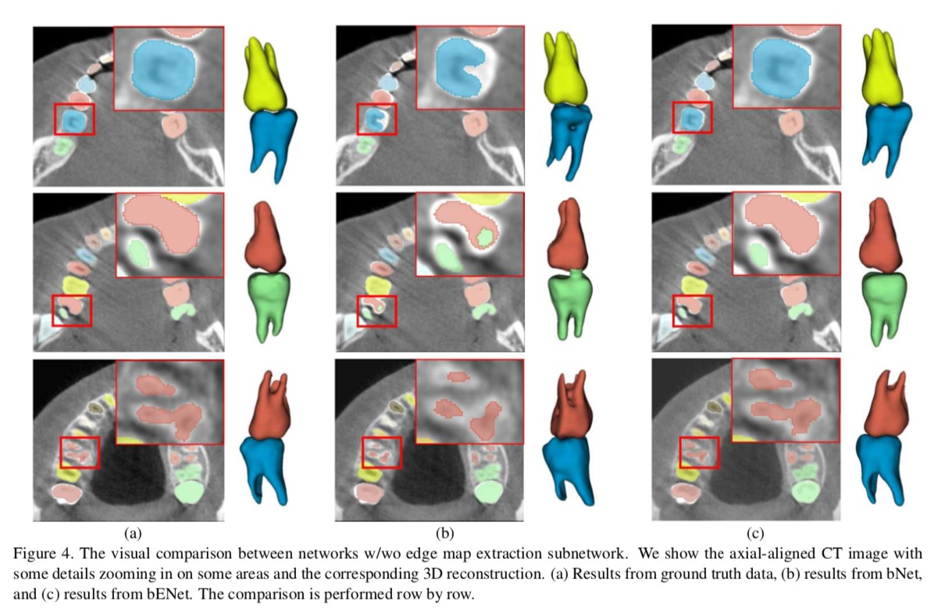
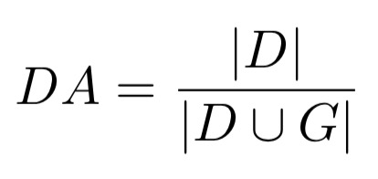
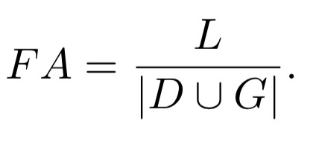
Results
w/wo Edge Map
Tooth segmentation accuracy:
Dice similarity coefficient metric (DSC)
Detection accuracy (DA)
Identification accuracy (FA)
Y: voxelized prediction results
Z: ground truth masks
G: set of all teeth in ground truth data
D: set of teeth detected by proposed network
L: right teeth labels

Slide 19
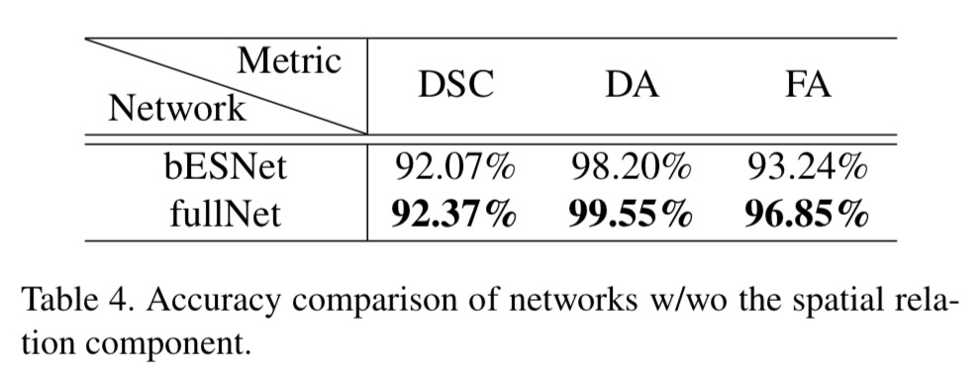
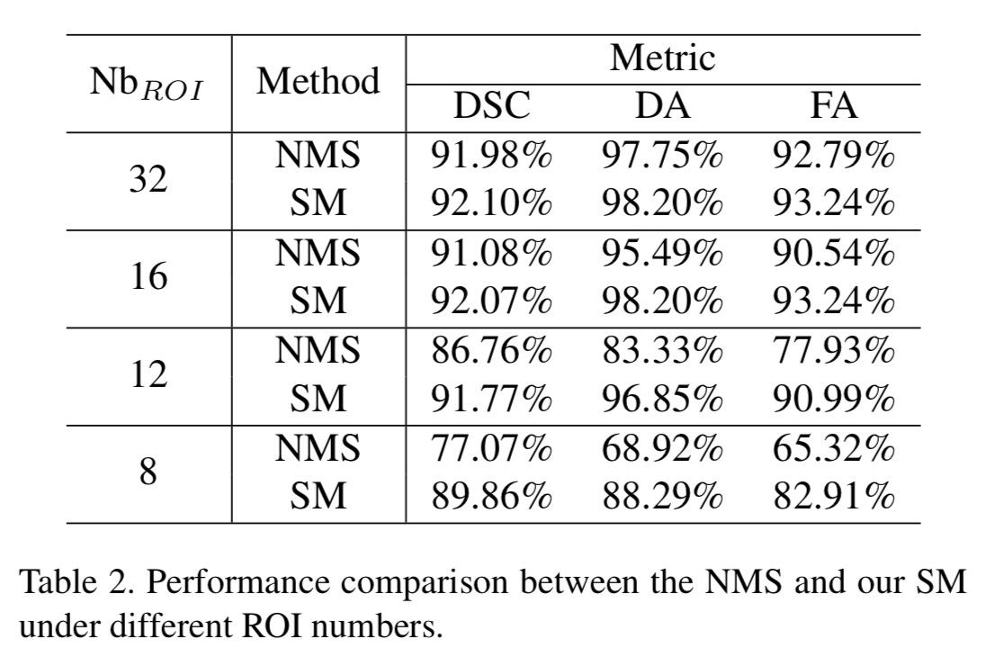
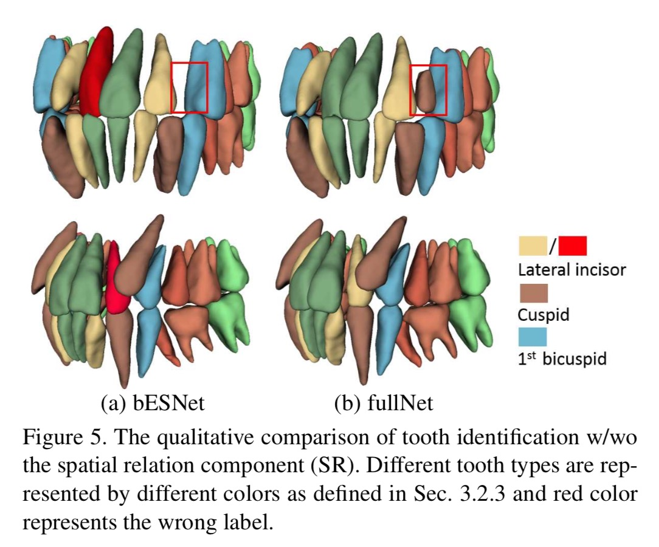
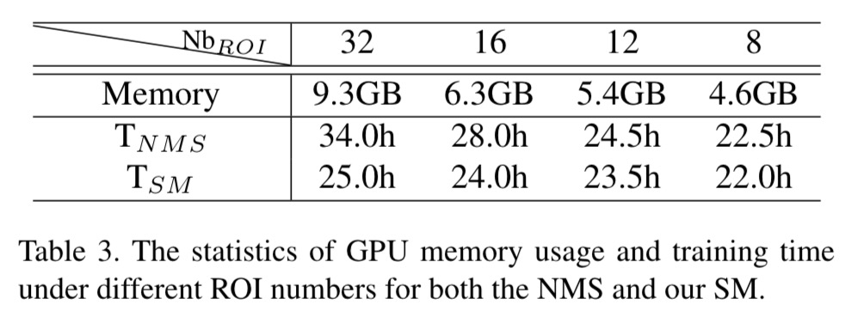
w/wo Similarity Matrix
w/wo Spatial Relation Component

Slide 20
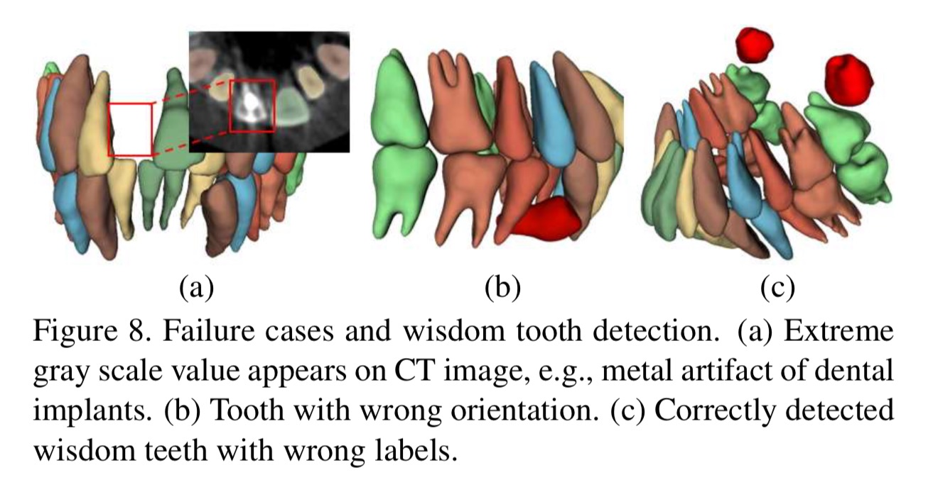
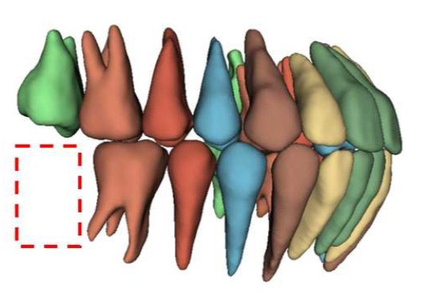
Failure Case:
When there is extreme gray scale value in CT image
The identification will fail if the tooth has the wrong orientation
Wisdom Tooth
When feeding this tooth to the network, it detects and segments it successfully
Since the label for the tooth is never added, thus shown in red (wrong)
Incomplete teeth:
remove
Testing dataset include data with incomplete teeth

